Slide 1
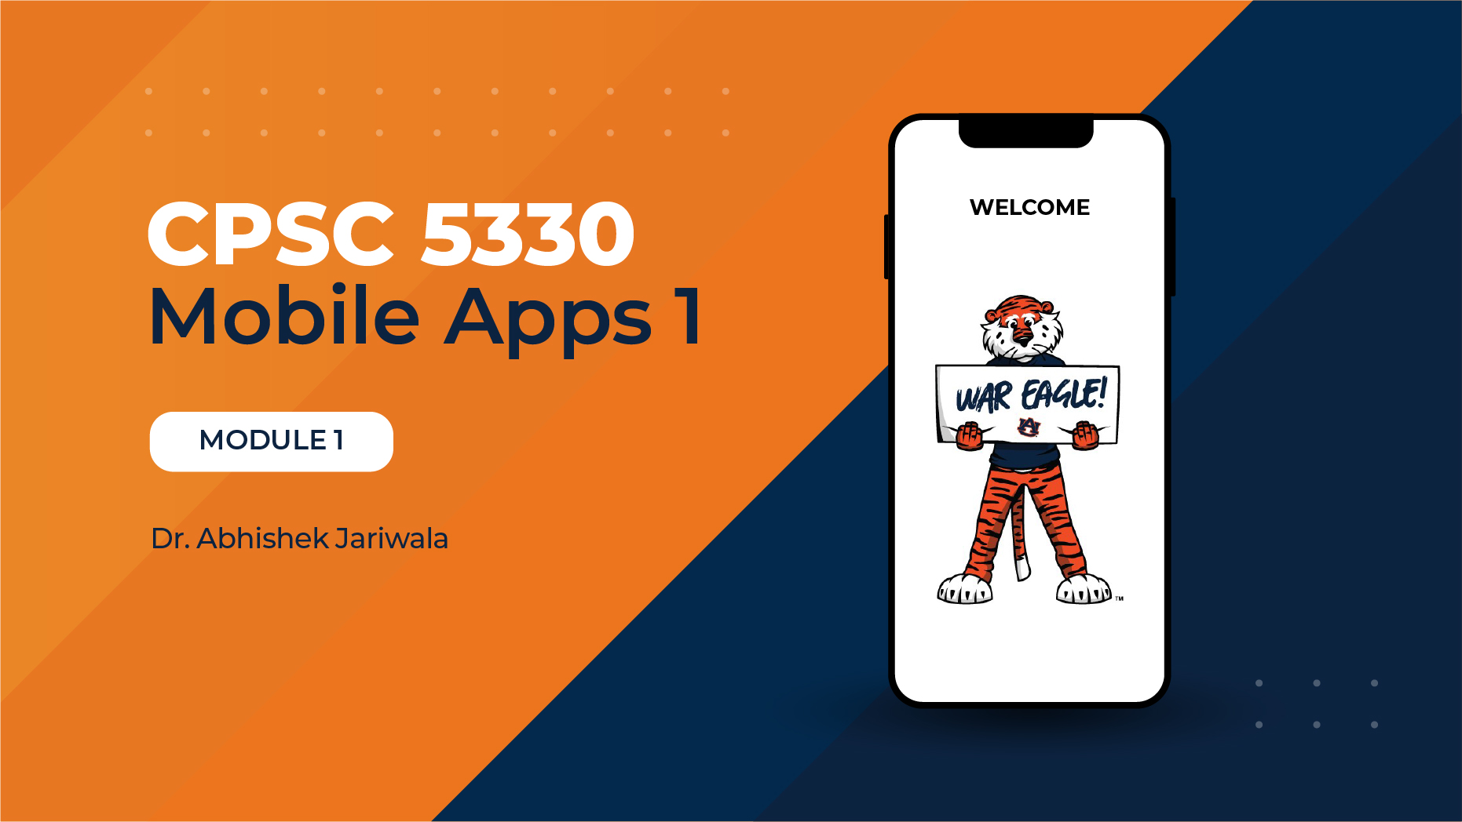

Slide 2



Mobile Application Development Process

Slide 3









The Roadmap
PROTOTYPE
SWIFT BASICS
REFINE
DESIGN
API
PUBLISH

Slide 4

Bugs!!!

Slide 5




Bugs!!!

Slide 6
Hardware and Software Requirements
Minimum Requirements (for Local Development):
Device: Mac computer
Operating System: macOS compatible with the latest Xcode
Storage: At least 25–30 GB free space (Xcode is large!)
RAM: 16 GB recommended for smooth performance
Optional: iPhone or iPad for physical device testing
Required Software:
Xcode: Apple’s IDE for iOS app development
Download from the Mac App Store
Apple ID: Needed to run apps on physical devices and access developer tools
Alternative Options (if you don’t own a Mac):
Macincloud: Virtual Mac rental (remote login to a macOS machine)
Xcodeclub: Another virtual Mac service - often faster and more flexible (remote access using AnyDesk)
Recommended: Choose 16 GB RAM plans
Simulators & Devices:
iPhone Simulator: Comes with Xcode, useful for most testing
Physical iPhone (Optional): Required if you plan to publish on the App Store

Slide 7


